Slide 1
Systems Development Competency
Extreme Programming (XP) Methodology
Last updated: Sept 13, 2003

Slide 2
Introduction
Instructor introduction
Classroom specifics
Room access
Restroom facilities
Start and end times
Eating facilities
Equipment & materials

Slide 3

Target Audience
Business Process Engineers: Responsible for confirming a project team’s understanding of existing business processes and identifying requirements of the future system.
Application Developers/Purchasers: Responsible for the analysis, design, selection, implementation, testing and/or deployment of the system.
IT Software Project Managers: Responsible for life-cycle project management, communicating to stakeholders & the project resources. Customers are welcome.

Slide 4

Course Objectives
Be extreme paced, but a fun kickstart
Understand the principles & values of XP
Understand the importance of using a methodology
Get hands on with key practices of XP
Understand how to business model, manage requirements, perform analysis & design using XP
Understand XP’s relationship with RUP & the P&G Competency
Get advice from industry & P&G experts
Understand where to go for additional help

Slide 5

This Course Is Not Intended To
Replace practitioner training
Give you hands on to the entire XP methodology
Teach you specific language skills such as Java or .NET
Practitioner
Training
You will be provided with additional materials and
reference for practitioner training.

Slide 6

Material Relevancy
Extreme Programming (XP) is a key industry standard methodology that addresses the new economy.
P&G endorses XP for small to medium projects (80% of our systems development efforts will benefit from it)
Using an industry standard methodology is especially relevant as we continue to work with vendors & off shore resources
P&G does much of this in one form or another (prototyping, agile modeling, rapid application deployment).

Slide 7

Vocabulary
In general, we’ll discuss terms like agile modeling, paired programming, user stories, spikes, release planning, iterations, acceptance tests, collective code ownership, Refactoring, project velocity and small releases
We’ll also relate these to key methodology sub-processes including business modeling, project management, requirements management, analysis & design, implementation, testing, deployment and configuration & change management

Slide 8

Class Introduction
Who am I? Why am I here?
Attendee introductions
  name,
  location,
  position
Background and interests
Discuss attendee methodology experiences
Materials
  slides
  manual
  materials in room
  websites

Slide 9

Plan Of Attack
8:00am How XP Fits at P&G, History & Benefits of Using
8:15am Principles & Values
8:30am XP Project Management
9:15am Iteration & Release Planning Exercise
9:45am Break
10:00am XP Plug-in for RUP
10:15am XP Business Modeling
10:45am XP Requirements Management
11:45am Lunch
12:30pm XP Requirements Management (continued)
12:45pm User Stories & Agile Modeling Exercise
1:00pm XP Analysis & Design
1:30pm XP Implementation & Testing
2:00pm Break
2:15pm Class Exercise
2:40pm Additional XP Areas (Tools, Examples, Principles)
4:15pm Additional Materials & Reference
4:30pm Wrap up

Slide 10
IT Competencies Relationships
Business Unit OGSM
Possibilities and Priorities
Master Planning &
Architecture
BU Master Plan
Trends and changes
BU IT Action Plan
Architecture
Review and Approval
Business process and Technology choices
Business Processes
Project Initiation and Stage Approvals
Technologies
Project
Management
System
Development
Defined System Development
Project Templates
Data and decisions
Change Requests and Service Level Requirements
Priorities & projects
Business Analysis
(technology enabled)
Service
Management
Business Unit Results

Slide 11

P&G-Endorsed Approach
We buy for competitive parity
We build for competitive advantage
We use industry standards
When building we use:
  Java
  .NET
  HTML
Buy vs. Build
Java,
HTML,
.NET
Choices here can depend upon other factors such as backend database,
application server, development environment, organizational skill level,
application performance & size, customer environments, etc.

Slide 12
Competency Training Framework
Introduction
1. “Systems Development Competency-Survivalist Course”
(Methodologies, techniques, tools, environment, languages)
90% IT Employees
2. XP
Methodology
3. UP
Methodology
Attend a methodology class then specialize by role.
Methodology
Practitioner
Practitioner Training By Role
Programmer might take 1,2,7 & 9
Architect might take 1,2,4,5,6 & 12
Process Engineer take 1,3,4,5, & 8
4. Business
Modeling
5. Requirements
Management
6. Database
Design
7. OO/UML
Tools &
Techniques
8. CMM
Assessment
Approaches
Building Systems
Buying Systems
9. Java
10 .NET
(C#, VB)
11. Web
(HTML,
Javascript, JSP)
12. Purchased
Packages
(Siebel, SAP)
Language and package
Training as needed
Detailed language classes shown on next slide
Training path typically follows yellow arrows.
.NET Path
Author: D.G. Adams
Last updated: 06/17/03

Slide 13

Methodology Definition
A software methodology is the set of rules and practices used to create & deploy computer applications.
A heavyweight methodology has many rules, practices, and documents. It requires discipline and time to follow correctly.
An Agile methodology has fewer rules and practices or ones which are easy to follow.
There are different levels of risks associated with the Agile vs. heavyweight methodology approaches
Extreme Programming (XP): it's more about mindset, attitude, values, and principles.

Slide 14

P&G-Endorsed Methodologies
Extreme programming (XP)
Rational Unified Process (RUP)

Slide 15


With 3 straight lines, separate
the apples from the oranges.
Apples & Oranges

Slide 16
How To Choose A Methodology
Characteristics
Extreme Programming
Rational Unified Process
Project Size
Small to medium
Medium to large
Delivery time
Need quick prototype delivery
Can afford to be more thorough, developing key modules
Number of development resources
Up to a dozen programmers
More than a dozen
Programmer Approach
Programmers in same location
(sitting in same room). All programmers are interchangeable
Geographically dispersed programmers. May have a need for role separation.
Code Review Approach
Pair programming (code reviewed as written). Minimal duplicate code.
May involve more than two programmers with code reviews, testing. May need code duplication.
Iteration Size
Iterations may be 1, 2 or 3 weeks long
Iterations may be longer than 3 weeks
Release Approach
Characterized by small and often releases. Start with small, useful feature set. Customers are available to accept multiple releases.
Releases can be planned out. May include larger module releases. Customer may want single release to minimize user impact.
Project Documentation
The code is the documentation. May allow for some models
Allows for visual models. Models may be used to generate downstream code.

Slide 17
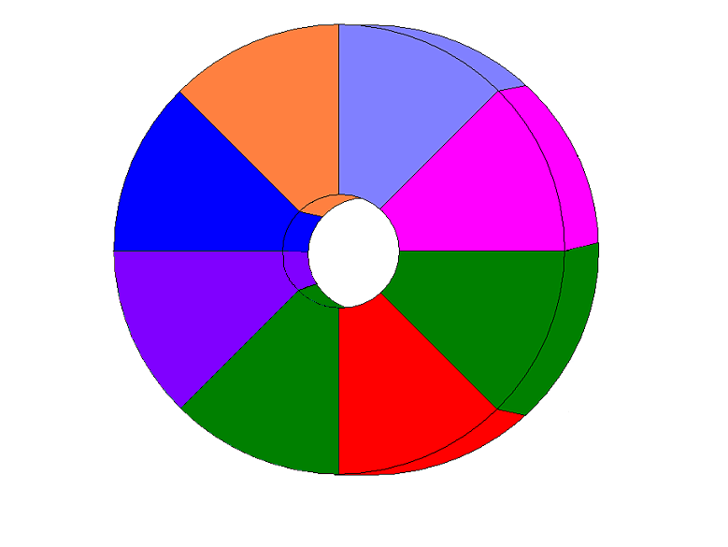
Methodologies
Tools &
Techniques
Business
Modeling
Requirements
Management
Project &
Environment
Management.
Analysis &
Design
Configuration
& Change
Management
Implementation
Developer &
Customer Bill
of Rights
Standards &
Specifications
Deployment
Testing
Systems Development Competency
“Key Processes Framework”
Notes:
Competency includes key processes that feed an iterative, incremental project approch.
Business modeling: Understanding & visually depicting business processes
Requriements mgmt: identifying & managing what customers want
Analysis & Design: Transforming requirements in a system-to-be.
Implementation & Testing: Define & test code organization against reqts.
Deployment:Make system available to end users via support and training
Config & Change Mgmt: Manage changes during lifecycle
Project Mgmt: Plans the project & iterations taking into account resource needs.
Competency includes direction on methodologies, tools & techniques (e.g. Visio), bill of rights and standards & specifications (e.g. OO & UML).

Slide 18
Competency Sub-process Definition
Business Modeling: Provides guidance for the Analyst on how to understand and visually depict a business through modeling.
Requirements Management: Involves finding, maintaining and managing requirements for the system. The business models developed in the modeling discipline are key inputs to these activities.
Analysis & Design: Transforms the requirements into a system-to-be design and adapts that design to match the implementation environment.
Implementation: Defines the organization of code and components, while testing the components as units. It then integrates the results into an executable system.

Slide 19
Competency Sub-process Definition
Testing: Validates the system against the requirements, ensuring that the system works properly
Deployment: Describes the activities associated with ensuring that the software product and related materials are available for end-users via support and training materials.
Configuration & Change Management: Ensures that changes are effectively documented and accepted during the project’s lifecycle. It allows the Analyst to identify how changes to requirements will affect the project.
Project & Environment Management: Plans the project and project iterations. Takes into account the project resource needs.

Slide 20
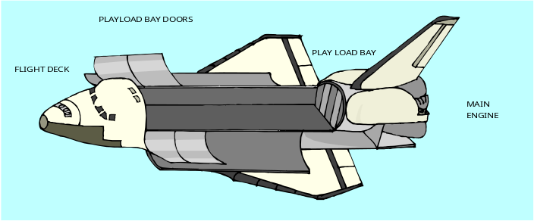
What Is XP?
Its not rocket science.
A agile, efficient, low-risk, flexible, predictable, scientific discipline for software development
It is different from other methodologies in that it:
  is focused on early & continuing feedback from short cycles
  uses an incremental planning approach with the plan evolving through the project lifecycle
  allows one to flexibly schedule to respond to changing business needs
  relies on automated tests written by programmers & customers to monitor progress & catch defects
  relies on oral communication, tests and source code to communicate system structure & intent
  relies on an evolutionary design process
  relies on ordinary programmers with ordinary skills

Slide 21
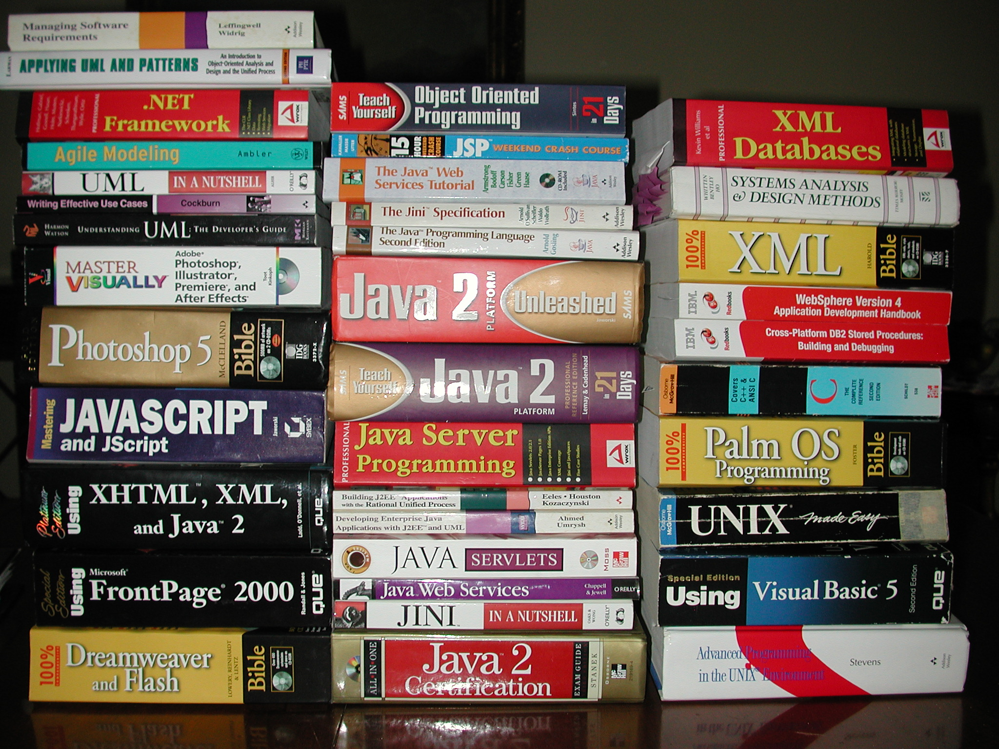
Class materials were based on P&G and industry
expertise, Internet research and extensive written material.

Slide 22
XP Background & History
XP has a few rules and a modest number of practices which make up the methodology.
In the early 1990s a man named Kent Beck was thinking about better ways to develop software. Complex methodologies & case tools were prevalent.
XP is successful because it stresses customer satisfaction.
The methodology is designed to deliver the software your customer needs when it is needed.
XP includes project phases of exploration, planning, Iterations To First Release, Productionizing, Maintenance & Death. These compare to RUP’s Inception, Elaboration, Construction & Transition.

Slide 23
XP Characteristics
Application developers deliver the system to the customers as early as possible and implement changes as suggested.
XP is designed for projects with 2-10 programmers that can execute tests in a fraction of a day. XP emphasizes teamwork between managers, customers and developers.
Pairs evolve the design of the system. Changes aren’t restricted to any particular area.
Integration follows development, including integration testing.
XP encourages a response to changing customer requirements, even late in the life cycle. XP enables us to embrace change. XP short cuts requested changes by getting customer feed back early while there is still time to change functionality or improve user acceptance.
XP emphasizes communications. Developers communicate with their customers and fellow programmers.

Slide 24
XP Characteristics
XP emphasizes not just testing, but testing well. Tests are automated and provide a safety net for programmers and customers alike.
Development is driven by tests. (test first, then code)
Tests are created before the code is written, while the code is written, and after the code is written.
Bugs don't get through twice, and this is something the customers will notice. XP requires an extended development team including the developers, managers and customers.
Improved productivity is a side benefit of XP. Let's stop at just enough rules to keep our software reliable and reasonably priced.

Slide 25
XP Core Values
There are four XP dimensions along which one can improve any software project.
  You need to improve communication (testing, pairing, estimating, learning).
  You need to seek simplicity (focus on the task at hand, eliminate over design).
  You need to get feedback on how well you are doing (unit tests, story estimates, schedule monitoring, functional tests).
  And you need to always proceed with courage (willingness to throw away code, fix architecture flaws, respect for others, learn, adapt, and improve.

Slide 26
Fundamental Principles
There are fundamental XP principles which include:
        Rapid feedback
        Assume simplicity
        Incremental change
        Embracing change
        Quality Work
These principles help us understand how to apply the various XP practices.

Slide 27
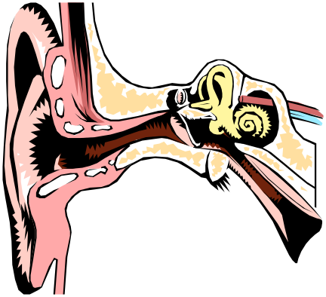
Basic Software Development Activities
According to Kent Beck, there are 4 development activities which are:
        Listening
        Designing
        Coding
        Testing
These relate to our methodology sub-processes of business modeling, requirements management, analysis & design, implementation, testing, deployment & project management. Our values & principles will guide us in how we do these.

Slide 28

The 12 Key Practices
The planning game: Quickly determine the scope of the next release by combining business priorities and technical estimates. As reality overtakes the plan, update the plan.
Small releases: Put a simple system into production quickly, then release new versions on a very short cycle.
System of Names: Guide all development with a simple shared story of how the whole system works.
Simple design: The system should be designed as simply as possible at any given moment. Extra complexity is removed as soon as it is discovered.
Testing: Programmers continually write unit tests, which must run flawlessly for development to continue. Customers write tests demonstrating that features are finished.
Refactoring: Programmers restructure the system without changing its behavior to remove duplication, improve clarity, simplify, or add flexibility.

Slide 29

The 12 Key Practices
Pair programming: All production code is written with two programmers at one machine, passing the keyboard back and forth.
Collective ownership: Anyone can improve any code anywhere in the system at any time.
Continuous integration: Integrate and build the system many times a day, every time a task is completed.
Sustainable Pace: Work a steady, predicable, productive pace. It’s a marathon not a sprint. Never work overtime a second iteration in a row.
On-site customer: Include a real, live user on the team, available full-time to answer questions and make all business decisions.
Coding standards: Programmers write all code in accordance with rules emphasizing communication through the code.
Practice support each other best when applied together.

Slide 30
The Interaction Between Practices
On-site Customer
Planning Game
Sustainable Pace
System Of Names
Simple Design
Short Releases
Testing
Refactoring
Continuous
Integration
Pair Programming
Collective Ownership
Coding Standards
The richness comes from the interaction of the practices.

Slide 31
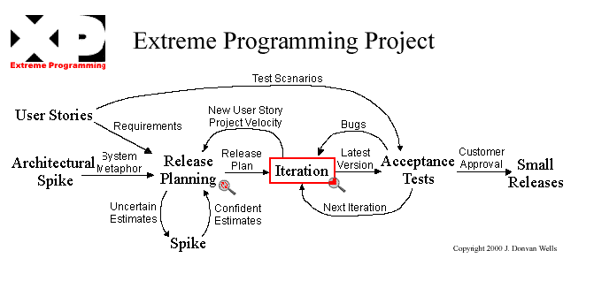
XP Overview
Things We Control
- Cost
- Time
- Quality
- Scope

Slide 32
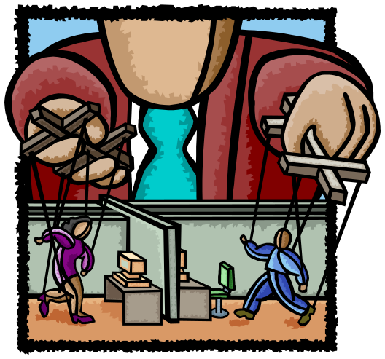
The Project Control Variables
Cost: More money can ease the schedule, but too much too soon can cause problems. Too little and the problem won’t be solved.
Time: More time to deliver improves quality but can increase scope.
Quality: Short-term gains can be made by sacrificing quality but other costs are enormous.
Scope: Less scope can improve quality and can help you deliver sooner & cheaper.

Slide 33
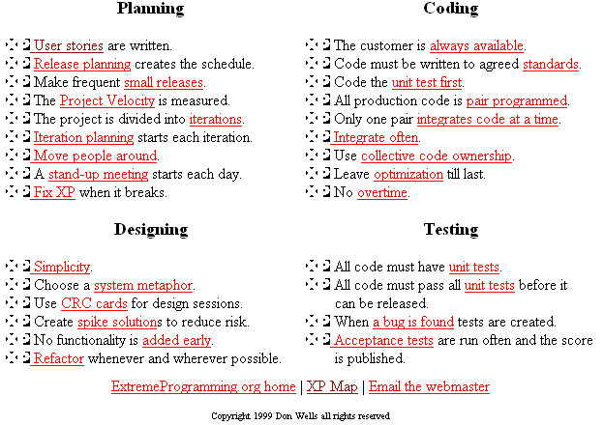
Example Detailed Principles

Slide 34

Planning Makes The Difference
Don has 1.5 minutes to
make 3 slices of French
toast. He must fry both
sides of a bread slice for
30 seconds. Don’s
manager gave him a
frying pan that can only
hold two slices of bread
at once. How can he do
this in 1.5 minutes vs. 2?
The answer is not to see if the customer
will accept eggs in stead of French Toast.

Slide 35

Project Management with XP
Goal: To maximize the value of software produced by the team.
The Strategy: For the team to invest as little as possible, as quickly as possible, for the most valuable functionality, taking into account strategies to reduce risk.

Slide 36
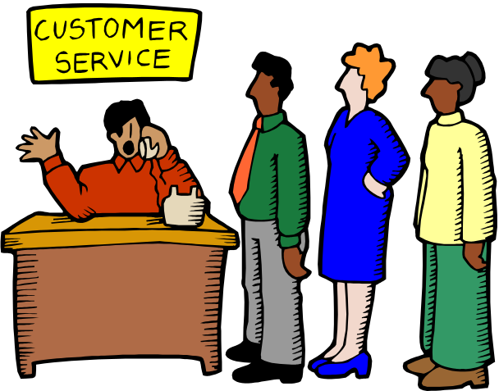
Project Management with XP
Key Steps In The Process:
Find out what the customer wants,
make sure you know what they want,
estimate the effort to complete,
build the solution,
and deploy to the customer.
repeat this cycle over and over.
XP projects involve chunking down a vision into releases and the iterations that make up each release. Planning is seen as an evolving process that's refined and tuned over the life of the project.

Slide 37
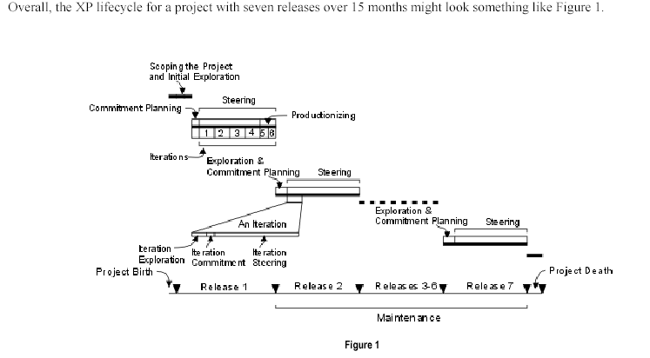
Project Management with XP
Stages
Exploration
Planning
Iterations to First Release
Productionizing
Maintenance
Death

Slide 38
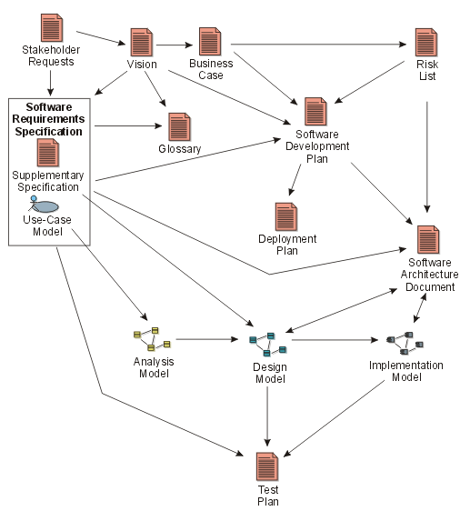
Example Project Artifacts

Slide 39
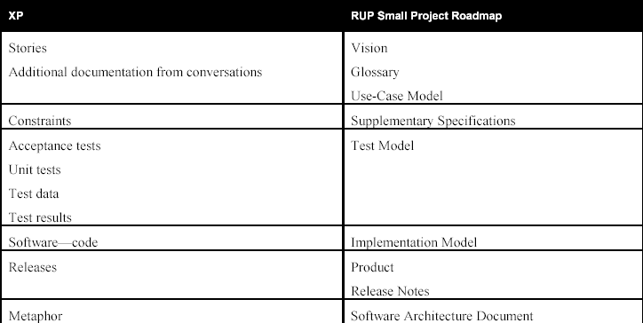
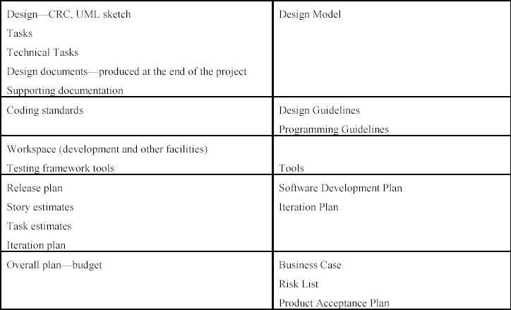
Determine What Outputs You’ll Deliver With A Development Case

Slide 40
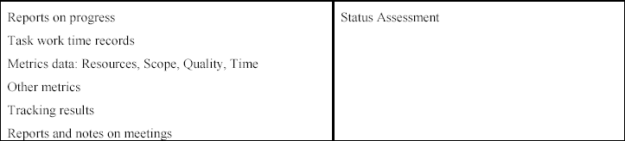
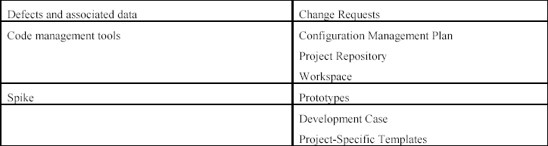
Determine What Outputs You’ll Deliver With A Development Case

Slide 41

Getting Started With XP
Start out collecting user stories and conducting spike solutions for things that seem risky. Spend only a few weeks doing this.
Then schedule a release planning meeting. Invite customers, developers, and managers to create a schedule that everyone agrees on.
Begin your iterative development with an iteration planning meeting.
Business people decide scope, priority, composition of releases & dates of releases. Technical people decide estimates, consequences, process, detailed scheduling.
If you are having a chronic problem with changing requirements causing you to frequently recreate your schedule, then try a simpler and easier release planning meeting every few iterations.
If your biggest problem is the number of bugs in production, then try automated acceptance tests. Use this test suite for regression and validation testing.
If your biggest problem is integration bugs then try automated unit tests. Require all unit tests to pass (100%) before any new code is released into the code repository.

Slide 42
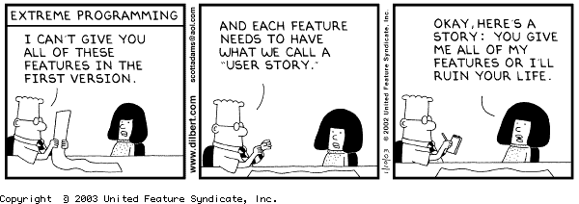
User Stories Are Key Drivers

Slide 43

Iterative, Incremental Approach
Iterative: involving repetition (chunks)
Incremental: increasing in quantity (build on previous)
Definition: Deliver small incremental components
into production every few weeks. Build on previous
steps.

Slide 44

Iterative, Incremental Characteristics
Supported in both XP & RUP methodologies.
Can get going without all requirements up front.
Helps deal with real change during project.
Review requirements after every small step.
Review all requests every few weeks.
Deliver the next most important thing.
Have the user present. Interpretation is dangerous.
See the real thing, model when appropriate.
Build in and prove it is defect free.

Slide 45
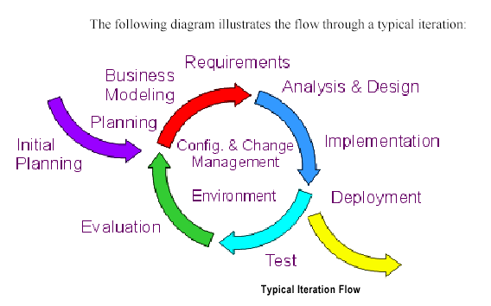
Iterative, Incremental Cycle

Slide 46
Iteration Planning Meeting
An iteration planning meeting is called at the beginning of each iteration to produce that iteration's plan of programming tasks. Each iteration is 1 to 3 weeks long.
User stories are chosen for this iteration by the customer from the release plan in order of the most valuable to the customer first.
Failed acceptance tests to be fixed are also selected.
The customer selects user stories with estimates that total up to the project velocity from the last iteration.
The project velocity (or just velocity) is a measure of how much work is getting done on your project. To measure the project velocity you simply add up the estimates of the user stories that were finished during the iteration.
The user stories and failed tests are broken down into the programming tasks that will support them.
Keep an eye on your project velocity and snow plowing. You may need to re-estimate all the stories and re-negotiate the release plan every three to five iterations, this is normal.

Slide 47
Iteration Planning Meeting
Developers sign up to do the tasks and then estimate how long their own tasks will take to complete. The developer who accepts a task should be the one who estimates how long it will take to finish.
Tasks are written down on index cards like user stories. While user stories are in the customer's language, tasks are in the developer's language. Duplicate tasks can be removed. These task cards will be the detailed plan for the iteration.
Each task should be estimated as 1, 2, or 3 ideal programming days in duration. Ideal programming days are how long it would take you to complete the task if there were no distractions.
Tasks which are shorter than 1 day can be grouped together. Tasks which are longer than 3 days should be broken down farther.
Now the project velocity is used again to determine if the iteration is over booked or not.
Total up the time estimates in ideal programming days of the tasks, this must not exceed the project velocity from the previous iteration. Too much and the customer must choose user stories to be put off until later iterations.

Slide 48
Release Planning Meeting
A release planning meeting is used to create a release plan, which lays out the overall project.
The essence of the release planning meeting is for the development team to estimate each user story in terms of ideal programming weeks.
The release plan specifies exactly which user stories are going to be implemented for each system release and dates for those releases.
This gives a set of user stories for customers to choose from during the iteration planning meeting to be implemented during the next iteration based on perceived priority.
These selected stories are then translated into individual programming tasks to be implemented during the iteration to complete the stories.
When the project velocity changes dramatically for a couple iterations or in any case after several iterations go ahead and schedule a release planning meeting with your customers and create a new release plan.

Slide 49
Release Planning Meeting
Every release should be as small as possible, containing the most valuable business requirements. You may plan by time or scope.
The project velocity is used to determine either how many stories can be implemented before a given date (time) or how long a set of stories will take to finish (scope).
When planning by time multiply the number of iterations by the project velocity to determine how many user stories can be completed.
When planning by scope divide the total weeks of estimated user stories by the project velocity to determine how many iterations till the release is ready.
When the final release plan is created and is displeasing to management it is tempting to just change the estimates for the user stories. You must not do this. Negotiate until the developers, customers, and managers can all agree to the release plan.
The release planning meeting is used to discover small units of functionality that make good business sense and can be released into the customer's environment early in the project.

Slide 50

How Risk Shapes The Process
  Q: We might ask should we model the business?
  A: If there is significant risk that failing to do so might cause us to build the wrong system then we should do some level.
  Q: Do we need to do formal business modeling?
  A: If our team is small, we might not need to. If it will be shared with other organizations then we probably will need to.

Slide 51


Risk Reduction Drives Iterations
Define scenarios to address highest risks
Plan Iteration N
Cost
Schedule
Initial Project Risks
Initial Project Scope
Develop Iteration N
Collect cost and quality metrics
Iteration N
Assess Iteration N
Revise Overall
Project Plan
Cost
Schedule
Scope/Content
Revise Project Risks
Reprioritize
Risks Eliminated
Notes:
51

Slide 52
Iterative Features & Benefits
Features
Iteration makes complex projects possible and minimizes risks.
No longer do you deliver in one lump near the end delivery date.
Frequent, executable releases.
Attack risks through demonstrable progress. Progress
measured in products, not documentation or engineering estimates.
Benefits
Releases are a forcing function that drives the development team to closure at regular intervals.
Change requests don’t disrupt current work.
The project’s supporting elements (testers, programmers, tool masters, etc.) can better schedule their work.

Slide 53

Iterative Factors of Success
Factors of Success
Be proactive and attack risks. Seek out stakeholders
Begin with the end in mind. Use milestones.
Put first things first. Organize and perform by priority.
Satisfy a maximum number of business needs with minimum of effort.
Understand business goals before seeking solutions.
Synergize. The value of a team is greater than the sum of its individuals.
Sharpen the saw. Learn and improve as you go.
Defined Binary tasks driven to completion.
Tasks are either done or not done.
Tasks are never “80% complete”.

Slide 54
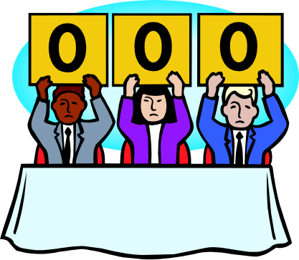
Iterative Reasons for Failure
Reasons for failure
Lack of effective communications
Lack of buy-in for an Iterative Development approach
Faulty methodology
Poor requirements gathering & documentation
Lack of unified tool use
Non-binary deliverables.
Defects passed forward into next iteration.
Ugly code (not Refactored) passed forward into next iteration.

Slide 55
Project Management with XP
Iterative Development adds agility to the development process. Divide your development schedule into about a dozen iterations of 1 to 3 weeks in length.
Keep the iteration length constant through out the project. This is the heart beat of your project. It is this constant that makes measuring progress and planning simple and reliable in XP.
Concentrate your effort on completing the most important tasks as chosen by your customer, instead of having several unfinished tasks chosen by the developers.
Don't schedule your programming tasks in advance. Instead have an iteration planning meeting at the beginning of each iteration to plan out what will be done. Just-in-time planning is an easy way to stay on top of changing user requirements.
Take your iteration deadlines seriously! Track your progress during an iteration. If it looks like you will not finish all of your tasks then call another iteration planning meeting, re-estimate, and remove some of the tasks.

Slide 56
XP Plug-In for RUP Product
Demo the XP Plug-In For RUP
Show example iterations PDF file
Show example MS Project XP Plan

Slide 57
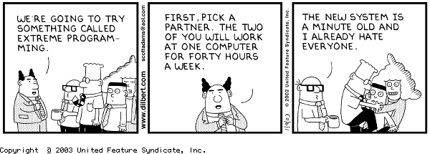
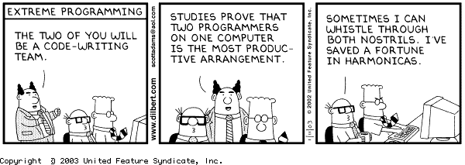
Release Planning Exercise
Given user stories, hold a release planning meeting

Slide 58
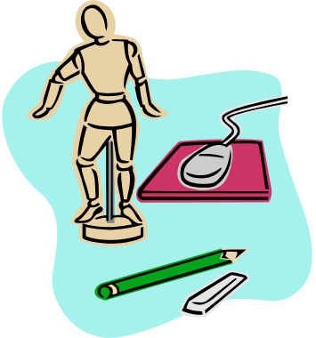
Business Modeling with XP
Use Agile Modeling principles (Scott Ambler book)
Only model what is necessary (target audience & purpose)
Doesn’t have to be formal (e.g. draw & use digital camera)
Consider informal use case diagrams as needed

Slide 59
What Do We Model With UML?
Business Process Model: A business process is a collection of activities designed to produce a specific output for a particular customer or market. It implies a strong emphasis on how the work is done within and organization, in contrast to a product's focus on what. A process is thus a specific ordering of work activities across time and place, with a beginning, an end, and clearly defined inputs and outputs: a structure for action. We need to confirm our understanding of current business processes to know what we’re improving.
Use Case Model: The Use Case Model describes the proposed functionality of the new system. A Use Case represents a discrete unit of interaction between a user (human or machine) and the system. A Use Case is a single unit of meaningful work; for example login to system, register with system and create order are all Use Cases. Each Use Case has a description which describes the functionality that will be built in the proposed system.
Class Model: The Class Model is at the core of object-oriented development and design - it expresses both the persistent state of the system and the behavior of the system. A class encapsulates state (attributes) and offers services to manipulate that state (behavior). Good object-oriented design limits direct access to class attributes and offers services which manipulate attributes on behalf of the caller.

Slide 60
What Do We Model With UML?
Physical Model: The physical model shows where and how system components will be deployed. It is a specific map of the physical layout of the system. A deployment diagram illustrates the physical deployment of the system into a production (or test) environment. It shows where components will be located, on what servers, machines or hardware.
Component Model: The component model illustrates the software components that will be used to build the system. These may be built up from the class model and written from scratch for the new system, or may be brought in from other projects and 3rd party vendors. Components are high level aggregations of smaller software pieces, and provide a 'black box' building block approach to software construction.
Dynamic Model: The dynamic model is used to express and model the behavior of the system over time. It includes support for activity diagrams, state diagrams, sequence diagrams and extensions including business process modeling. As an example, sequence diagrams are used to display the interaction between users, screens, objects and entities within the system. It provides a sequential map of message passing between objects over time.

Slide 61
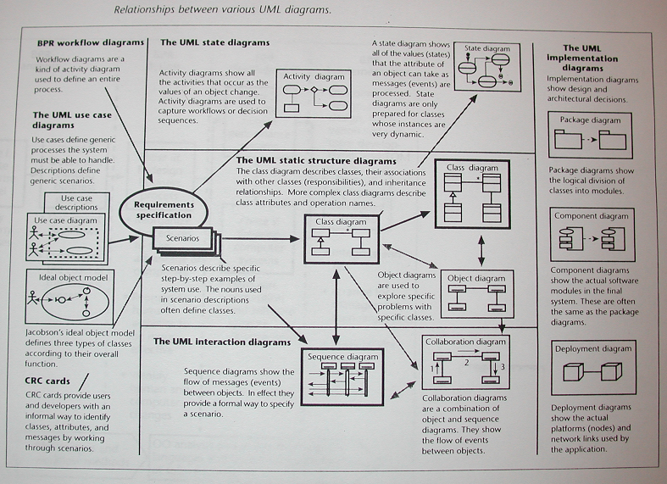

Slide 62
Business & Object Model Concepts
Object modeling is about exploring, discovering and recognizing the overall structure of the problem that our software system or component is trying to solve.
Business Model: A pictorial view of a set of logically related tasks (business processes) performed to achieve a business outcome
Business Process Re-engineering: Radical analysis and redesign of business processes in order to achieve dramatic ROI, performance and quality improvements, etc.
Object: A tangible or abstract thing of relevance to business; a data item (e.g. invoice).
The ability to model, analyze and re-design business processes is a core IT skill.

Slide 63
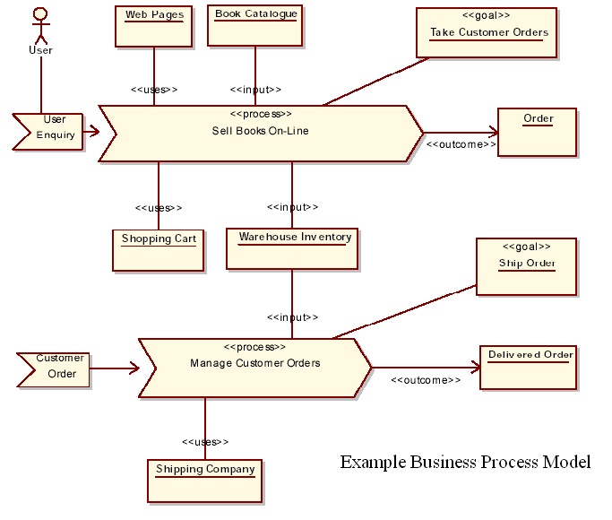

Slide 64

P&G Endorsed UML Artifacts
Real P&G Projects have benefited from:
Use Case Specification
Use Case Diagrams
Deployment Diagrams
Class Diagrams
Sequence Diagrams
Swimlane Diagrams

Slide 65
Use Case Diagram
Definition: A picture of the system’s behavior as a set of actors, communications, and use cases.
When to use: To serve as a communication tool that summarizes the behavior of a system and its actors.
Watchouts: Don’t spend hours on diagramming. Only do it when you need to. You may need other diagrams (e.g. to show info flow).

Slide 66
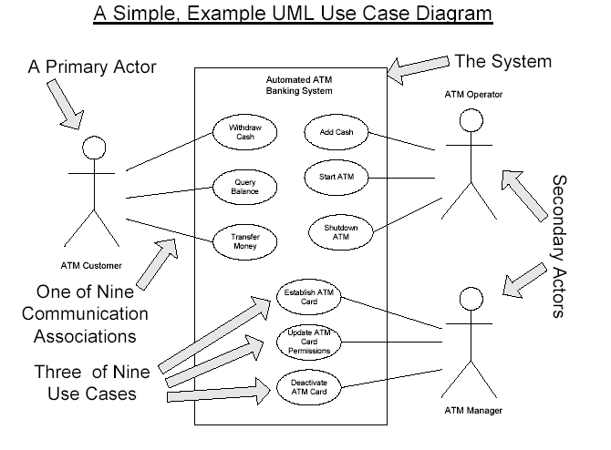

Slide 67
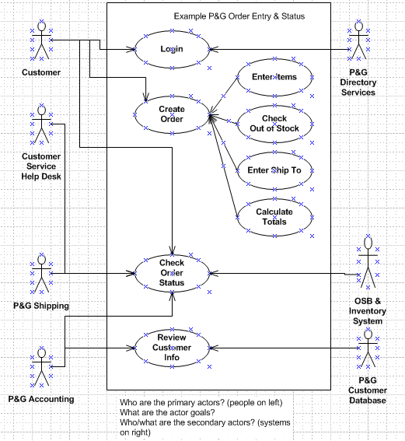

Slide 68
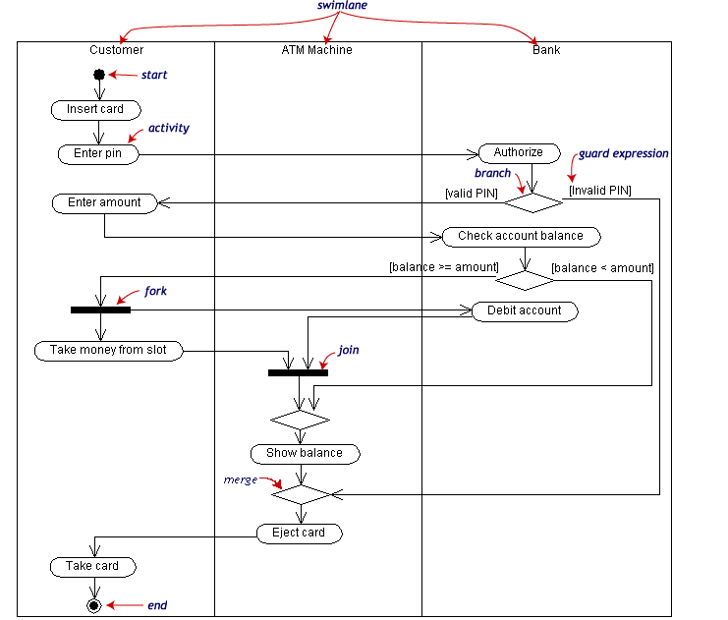
Swimlane Diagrams
Swimlanes partition groups of activities

Slide 69
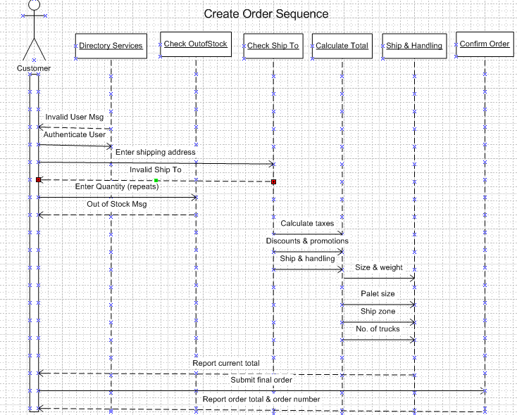

Slide 70
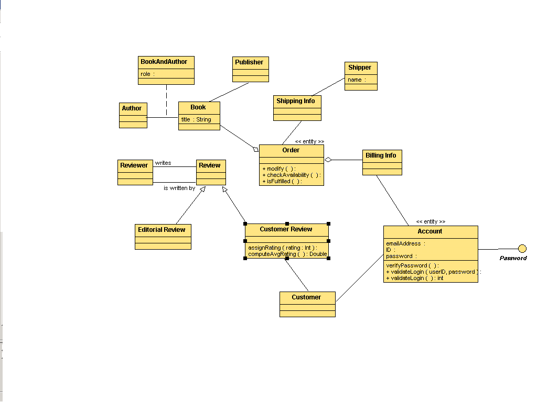
Class Diagram Example
IT Systems Development Competency Training

Slide 71

UML Diagram Tips
Have an audience & purpose in mind when diagramming.
Diagram only what is necessary.
Use simple modeling tools that meet needs.
Don’t suffer from ‘modeling waddling’ (clumsy)
Don’t get stuck in ‘paralysis analysis’ (cumbersome)
Sequence Diagram
Deployment Diagram
Use Case Diagram
Confusion Diagram
Drownlane Activity Diagram
Collaboration Diagram
Clumsy Diagram
Cumbersome Diagram
Component Diagram

Slide 72
Modeling Summary
Only model when you have a purpose and audience in mind. Code gives you more meaningful feedback.
The use cases specification document is a key driver in understanding current processes & user requirements.
The use case spec. helps you pull the right info from the subject matter expert. Consider a digital camera.
The use case specification is text-based so use it before jumping into visual modeling. This is a core IT skill.
Use case models provide a useful technique which help us to clarify exactly what the system is supposed to do.
Various diagramming artifacts are available for modeling. Avoid analysis paralysis & modeling waddling.
A development case can help drive which diagrams will be used as organizational standards.

Slide 73

Lunch Time: 45 min.

Slide 74
It Just Doesn’t Add Up
Place the numbers one through nine
in these circles so that the sum of
the three circles in any row equals
fifteen?

Slide 75
Requirements Management with XP
User stories are used to create time estimates for the release planning meeting.
They are also used instead of a large requirements document.
User Stories are written by the customers as things that the system needs to do for them.
They are similar to usage scenarios, except that they are not limited to describing a user interface.
They are in the format of about three sentences of text written by the customer in the customers terminology without techno-syntax.
One can use the ‘informal’ use case specification form to do this.

Slide 76
User Stories/Use Cases Drive the Iteration Process
Inception
Elaboration
Construction
Transition
Iteration 1
Iteration 2
Iteration 3
“Mini-Waterfall” Process
For each iteration choose
which user stories you’ll deliver.
Build upon previous use cases
Iteration Planning
Rqmts Capture
Analysis & Design
Test
Implementation
Prepare Release
Notes:
52
Each phase is divided into one or more iterations. Each iteration is defined in terms of the scenarios it implements. The classes needed to implement all selected scenarios are developed in a mini-waterfall development process.

Slide 77

User Stories
User stories should only provide enough detail to make a reasonably low risk estimate of how long the story will take to implement.
At implementation time, the developer will go to the customer for more level of detail. Keep stories focused on user goals.
Each story will get a 1, 2 or 3 week estimate in "ideal development time".
About 80 user stories plus or minus 20 is a perfect number to create a release plan during release planning.
You should try to avoid details of specific technology, data base layout, and algorithms.

Slide 78

Use Case Specification
Definition: A set of instances, where each instance is a sequence of system performed actions that yields an observable result of value to a particular actor.
It is written text, not diagrams.
When to use: To describe functional requirements indicating what the system will do at the elementary business process level as a replacement for detailed feature lists. Focus on business understanding.
Watchouts: Don’t define a use case at too low a level;as a single step or subfunction (e.g. Process a sale vs. enter payment).

Slide 79
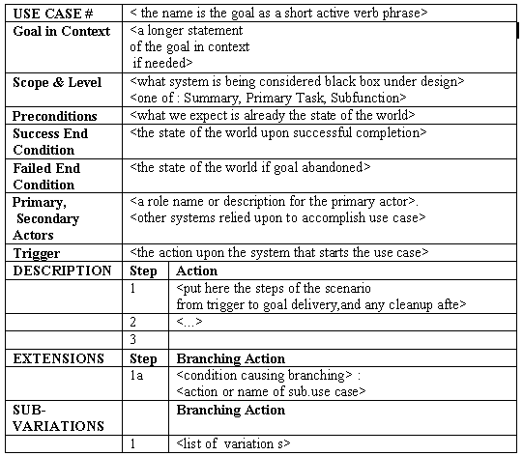
Formal Use Case Template
There may exist alternate course(s) for a use case

Slide 80
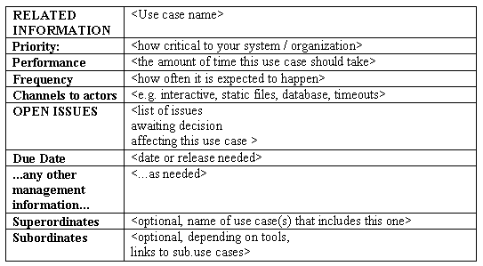
Formal Use Case Template part 2
There may exist alternate course(s) for a use case

Slide 81

Example User Stories
Students can purchase monthly parking passes online.
Parking passes can be paid via credit cards.
Parking passes can be paid via PayPal ™.
Professors can input student marks.
Students can obtain their current seminar schedule.
Students can order official transcripts.
Students can only enroll in seminars for which they have prerequisites.
Transcripts will be available online via a standard browser.
There may exist alternate course(s) for a use case

Slide 82
A Use Case Specification Approach
Who:
An analyst should prepare the use case vs. the subject matter expert. The expert will view use cases as a waste of time. Developers may focus on technology vs. business understanding.
How:
Identify primary actors
Identify each actor’s goals
Define use cases that satisfy user goals

Slide 83

User Stories & Agile Modeling Exercise
Purpose: Prepare user stories & visual models using simple text and use case diagrams in an XP methodology.
Watch out for ‘analysis paralysis’ & ‘modeling waddling’.
Action: Using informal use case specification document and prepare a use case & sequence diagram for class presentation.
Outcome: Ability to prepare user stories & visually model to communicate requirements back to team resources.

Slide 84

Analysis & Design with XP
Design is accomplished in three ways on an Extreme Programming (XP) project. There are CRC cards, Refactoring, and pair programming.
A Use Class, Responsibilities, and Collaboration (CRC) Cards session proceeds with someone simulating the system by talking about which objects send messages to other objects.
CRC cards can be considered a strategic level of design, pair programming is at the tactical level and Refactoring serves both.
When we remove redundancy, eliminate unused functionality, and rejuvenate obsolete designs we are Refactoring.
Refactoring throughout the entire project life cycle saves time and increases quality.
Refactor mercilessly to keep the design simple as you go and to avoid needless clutter and complexity.
Keep your code clean and concise so it is easier to understand, modify, and extend. Make sure everything is expressed once and only once.

Slide 85

Anything Is Possible
You and four friends have
decided to split a bagel for
breakfast. No one is fussy
about the size of the piece
received. Is it possible to
divide a bagel into five
pieces using two straight
lines?

Slide 86

Analysis & Design with XP
A simple design always takes less time to finish than a complex one. So always do the simplest thing that could possibly work.
If you find something that is complex replace it with something simple. It's always faster and cheaper to replace complex code now, before you waste a lot more time on it.
Keep things as simple as possible as long as possible by never adding functionality before it is scheduled. Beware though, keeping a design simple is hard work.
Keep the system uncluttered with extra stuff you guess will be used later.
Only 10% of that extra stuff will ever get used, so you are wasting 90% of your time.
The right design runs all the tests, has no duplicated logic (e.g. parallel class hierarchies), states every important programmer intention, and has the fewest possible classes & methods
Again, Good Design: Passes Tests, Is Clear, No Duplication, Fewest Classes & Methods.

Slide 87
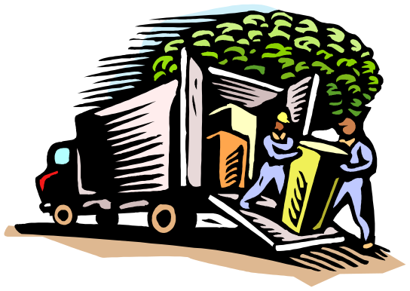
Deliver Key Functionality Now
By stepping through the process weaknesses and problems are easily uncovered. Design alternatives can be explored quickly by simulating the design being proposed.
We are all tempted to add functionality now rather than later because we see exactly how to add it or because it would make the system so much better.
It seems like it would be faster to add it now. But we need to constantly remind our selves that we are not going to actually need it.
Extra functionality will always slow us down and squander our resources.
Turn a blind eye towards future requirements and extra flexibility.
Concentrate on what is scheduled for today only.
Avoid ‘analysis paralysis’.
Sufficient unto the iteration are the Stories thereof – Robert Martin

Slide 88

What’s A Metaphor?
(to put cows in)
System Of Names - or - Conceptual Integrity
Each XP project is guided by a single overarching metaphor. Technical entities should be consistently taken from the System Of Names (e.g. contract management system).
Choose a System Of Names to keep the team on the same page by naming classes and methods consistently.
What you name your objects is very important for understanding the overall design of the system and code reuse as well.
Being able to guess at what something might be named if it already existed and being right is a real time saver.
Choose a System Of Names for your objects that everyone can relate to without specific, hard to earn knowledge about the system.
This will make it easier to communicate and elaborate between business and technical folks.

Slide 89

Design Strategy
Start with a test so we’ll know when we’re done. Objects & their visible methods.
Design and implement just enough to get the test running. This includes all previous tests.
Repeat. (XP revels in rework since risk is money like time is money)
If you ever see the chance to make the design simpler, do it.
The best design is the simplest design that runs all the test cases. (does what you want, no duplicate code, fewest possible classes & methods)

Slide 90
Implementation & Testing with XP
Unit tests help incorporate a programmer’s confidence in the program. Functional tests incorporate a customer’s confidence in the program.
Acceptance tests are created from user stories. They are automated with scores being published to the team.
During an iteration the user stories selected during the iteration planning meeting will be translated into acceptance tests.
The customer specifies scenarios to test when a user story has been correctly implemented. A story can have one or many acceptance tests, what ever it takes to ensure the functionality works.
Acceptance tests are black box system tests.
Each acceptance test represents some expected result from the system.
Code is integrated and tested after a few hours, a day at most.

Slide 91
Implementation & Testing with XP
When a bug is found tests are created to guard against it coming back. A bug in production requires an acceptance test be written to guard against it.
Customers are responsible for verifying the correctness of the acceptance tests and reviewing test scores to decide which failed tests are of highest priority.
Acceptance tests are also used as regression tests prior to a production release.
A user story is not considered complete until it has passed its acceptance tests. This means that new acceptance tests must be created each iteration or the development team will report zero progress.
Creating an acceptance test first before debugging helps customers concisely define the problem and communicate that problem to the programmers.
Quality assurance (QA) is an essential part of the XP process. On some projects QA is done by a separate group, while on others QA will be an integrated into the development team itself.

Slide 92
Unit & Acceptance Testing
Given a failed acceptance test, developers can create unit tests to show the defect from a more source code specific point of view.
Failing unit tests give immediate feedback to the development effort when the bug has been repaired.
When the unit tests run at 100% then the failing acceptance test can be run again to validate the bug is fixed.
First you should create or download a unit test framework to be able to create automated unit tests suites. Then you should test all classes in the system.
Create your tests first, before the code. Unit tests are released into the code repository along with the code they test.
Code without tests may not be released. If a unit test is discovered to be missing it must be created at that time.

Slide 93
Unit & Acceptance Testing
The biggest resistance to dedicating this amount of time to unit tests is a fast approaching deadline.
Unit tests enable collective code ownership. When you create unit tests you guard your functionality from being accidentally harmed.
Requiring all code to pass all unit tests before it can be released ensures all functionality always works.
Code ownership is not required if all classes are guarded by unit tests.
Consider dedicating a machine to integration testing where current releases and changes are loaded & tested until they are 100% correct. Single set integration with a pass/fail approach ensures quality.

Slide 94
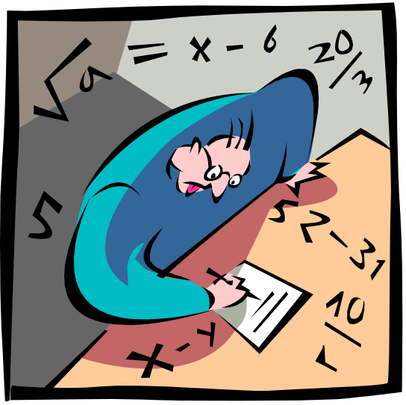
Testing Exercise
Discuss the difference between:
  Unit & Functional Testing
  Programmer & Customer Testing
  Code & Acceptance Testing
Developers write unit tests to make the interface to a method clear or to simplify the implementation. Write a test before you write the code.
Customers write functional tests by asking themselves what would have to be checked before I’m confident this story is done?

Slide 95
Additional XP Material
Move people around to avoid serious knowledge loss and coding bottle necks. Moving people around the code base in combination with pair programming does your cross training for you. Avoid single person dependencies.
Cross training is often an important consideration in companies trying to avoid islands of knowledge.
Remember the 40 hour work week rule. Overtime is a serious problem.
Simply encourage everyone to try working on a new section of the system at least part of each iteration.
Consider swapping out one pair of a ‘pair programming’ team.
XP is set up for small groups of programmers. Between 2 and 12, though larger projects of 30 have reported success.
XP requires an extended development team that includes not only the developers, but the managers and customers as well, all working together elbow to elbow.

Slide 96

Two Key Strategies For Managing Scope & Change
You get lots of estimating practice through feeding back actual results. Better estimates reduce the chance you’ll drop functionality.
Implement the customer’s most important requirements first so if further functionality has to be dropped it is less important than already running functionality.
Clean, simple, flexible, tested code can easily be changed as requirements change. Keep up with the code practices (Testing & Refactoring).
XP is like driving a car where constant, little changes are required to get there.
Keep your eyes on the road and be prepared to make the little adjustments.

Slide 97

Pair Programming
All code to be included in a production release is created by two people working together at a single computer (one keyboard, one mouse).
The person with the keyboard is focused on implementing the method at hand while the other is thinking strategically (fit with tests, simplification).
Pair programming increases software quality without impacting time to deliver. Pairing is dynamic and pairs change often.
It is counter intuitive, but 2 people working at a single computer will add as much functionality as two working separately except that it will be much higher in quality.
With increased quality comes big savings later in the project.
The best way to pair program is to just sit side by side in front of the monitor. Slide the key board and mouse back and forth.
One person types and thinks tactically about the method being created, while the other thinks strategically about how that method fits into the class.
It takes time to get used to pair programming so don't worry if it feels awkward at first.
Challenges: Small laptop displays & Computer in the Corner

Slide 98
Refactoring
Before and after implementing a program feature, programmers focus on improving the existing program to make adding the feature simple, while still running all the tests. This is called Refactoring.
When we remove redundancy, eliminate unused functionality, and rejuvenate obsolete designs we are Refactoring.
Refactoring throughout the entire project life cycle saves time and increases quality.
Refactor mercilessly to keep the design simple as you go and to avoid needless clutter and complexity.
Keep your code clean and concise so it is easier to understand, modify, and extend.
When the system requires you to duplicate code, it is asking for Refactoring.

Slide 99
Collective Code Ownership
Collective Code Ownership encourages everyone to contribute new ideas to all segments of the project.
Any developer can improve any line of code to add functionality, fix bugs, or refactor. No one person becomes a bottle neck for changes.
The way this works is for each developer to create unit tests for their code as it is developed.
All code that is released into the source code repository includes unit tests.
Once this is in place anyone can make a change to any method of any class and release it to the code repository as needed.
When combined with frequent integration developers rarely even notice a class has been extended or repaired.
In practice collective code ownership is actually more reliable than putting a single person in charge of watching specific classes. Especially since a person may leave the project at any time.

Slide 100
Collective Ownership
Anyone who can add value to code is required to do so at any time.
This is in contrast to no code ownership OR individual ownership.
No code ownership can lead to quick, unstable code growth and chaos between code relationships.
Individual ownership can result in a slow response to needed changes and dependencies on people who leave.
In XP, everyone takes responsibility for the whole of the system.
Everyone knows something about every part, though not everyone knows every part equally well.

Slide 101
The Project Manager’s Role
Highlight what needs to be done. Does not assign work.
Trust that the programmers want to do a good job. Help them do it even better. Get an open team workspace (cubbies around the bullpen).
Provide guidance all along vs. a policy manual in the beginning.
Be aware of how the XP culture clashes with company culture. Adapt.
Don’t impose overhead (long all-hands meetings, lengthy status reports).
Ensure your metrics are at realistic levels of accuracy (e.g. don’t account for every second if your watch only has a minute). Be willing to retire metrics that have served their purpose. Not too many metrics.
Keep a prominent chart (e.g. project tests, schedule, etc) to drive behavior.
Use metric numbers to gently and non-coercively communicate the need for change. Do the least amount possible to still be effective.
Use your own instincts as a barometer. If your stomach knots, something is wrong. Be willing to intervene, make unpopular decisions & see it through. Humility is the rule of the day for intervention. Accept how you let it get this way. Know when to stop the project or future enhancements.
Be a good coach & tracker. Get everybody to make good decisions. Get toys (e.g. lateral & critical thinking books) & food.

Slide 102

Deal With Your Limitation
Without the aid of a measuring device, how can you use a transparent 16-ounce mug to measure a volume of water that is exactly 8 ounces?

Slide 103
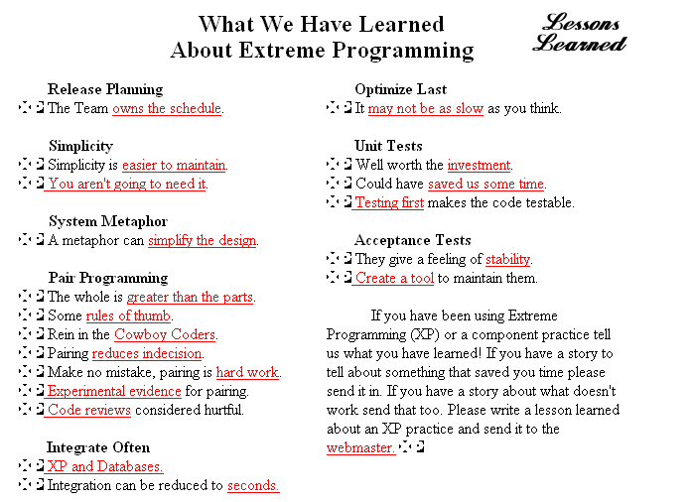
XP Learnings From The Experts

Slide 104
Some Useful Tools
Whiteboards, Post-it notes, index cards, digital camera
Use Case Specification (informal form)
MS Word (for use case specifications)
MS Visio for general diagramming
Praxus Estimating Tool
ArgoUML (free diagramming tools)
Project Wiki server
Testing: FitNesse, xUnit
Refactoring IDE like Eclipse, etc
Optimistic Source Control: CVS or SVC
Auto Build System: Cruise Control or Anthill

Slide 105

Where to Get More Information
Internal Web Sites
Sys Dev Competency Web Site : http://edlecom1.na.pg.com/sysdevcomp/default.htm
Sys Dev Competency COP Teamspace: http://sysdevcomp.internal.pg.com/
Java Community Of Practice Teamspace: http://javacop.pg.com/
.NET Community Of Practice Teamspace: http://dotnetdev.pg.com/
External Web Sites
Articles: www.xprogramming.org
Articles: www.objectmentor.com/resources/articleIndex
Extreme Programming: www.extremeprogramming.org
Agile Modeling: www.agilemodeling.com
Modeling: www.modelingstyle.info
Agile Alliance: www.agilealliance.com
Unit Testing: www.junit.org
Conferences: www.xpuniverse.com
Useful Authors
Kent Beck
Robert Martin
Craig Larman
Alastair Cockburn
Scott Ambler
Materials Owner: Don G. Adams

Slide 106
Where to Get More Information
Some Useful Books
Extreme Programming Explained: Embrace Change by Kent Beck
Planning Extreme Programming by Kent Beck, Martin Fowler
Agile Software Development, Principles, Patterns, and Practices by Robert C Martin
Agile Software Development by Alistair Cockburn
Agile Modeling: Effective Practices for Extreme Programming and the Unified Process
by Scott W. Ambler, Ron Jeffries
Writing Effective Use Cases by Alistair Cockburn
Lean Software Development (An Agile Toolkit) by Mary Poppendieck
Don’t let irrational opposing interests in the organization get in the way of success.
Materials Owner: Don G. Adams

Slide 107
A P&G XP Testimonial
We have adopted UML within TSC since February 2002 for projects being sourced through ITSS.
The main driver for this was the mismatch between vendor understanding of the needs and the customer expectation. We are focusing on the business modeling part (use cases, activity diagrams,...) which results in a business requirement definition document which is a key piece for sourcing application development work. We have seen significant impact, for example in the initial stages we had projects where after we have applied our UML process for BRD creation vendor quotes went down from 200,000$ to 75,000$.
If you are interested to discuss this in more detail, please feel free to contact me or Jack.
Regards,
Kurt Verbrugge- EUROPEAN TECHNICAL CENTER, Belgium

Slide 108
Top XP Reasons For Failure
Vision and scope not defined.
Customers not continuously involved.
All requirements are perceived as critical.
Requirements change, changes get lost.
Schedule slips, poor planning & estimating.
Functionality is never used.
Customer is not satisfied.
Team doesn’t collaborate & communicate.
Code not kept clean and tested.
Team stops learning & improving.
Panic.
Biggest barrier is culture.

Slide 109
Methodologies Address Fears
Like many methodologies, XP attempts to address fears such as:
Doing work that doesn’t really matter
Having projects canceled due to lack of technical progress
Making business decisions badly
Having business people make technical decisions badly
Coming to the end of a career and realizing you should have spent more time with the kids
Doing work you’re proud of.

Slide 110

Training Feedback
Please fill out the class evaluation sheet and help make this more effective for the next set of participants. Thank you.

Slide 111
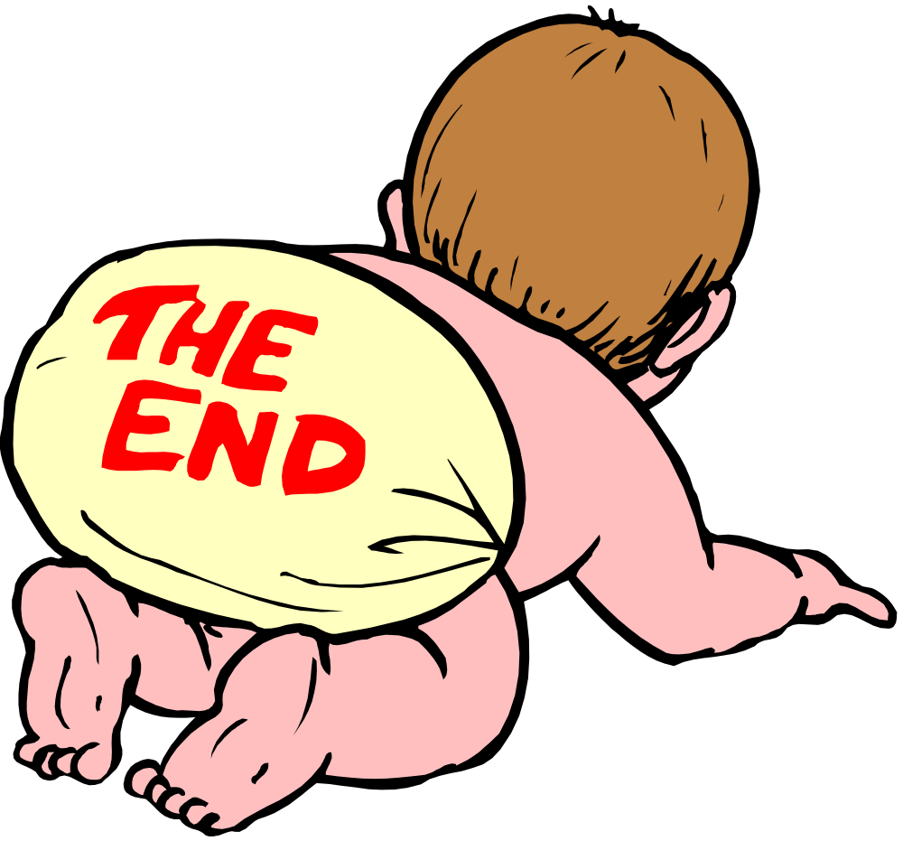
Thank you for your participation
Pampers

Slide 112
With 3 straight lines, separate
the apples from the oranges.
Apples & Oranges

Slide 113
It Just Doesn’t Add Up
1
6
2
7
5
3
8
4
9
Place the numbers one through nine
in these circles so that the sum of
the three circles in any row equals
fifteen?

Slide 114
Anything Is Possible
1
4
5
2
You and four friends have
decided to split a bagel for
breakfast. No one is fussy
about the size of the piece
received. Is it possible to
divide a bagel into five
pieces using two straight
lines?
3

Slide 115
Planning Makes The Difference
Don has 1.5 minutes to
make 3 slices of French
toast. He must fry both
sides of a bread slice for
30 seconds. Don’s
manager gave him a
frying pan that can only
hold two slices of bread
at once. How can he do
this in 1.5 minutes vs. 2?
Fry one side of two slices for 30 seconds. Flip
one slice over and replace the other slice with a
fresh slice of bread. At the end of 1 minute, remove
the completely fried bread. Return the unfried side
of the previous slice to the pan and flip the other
slice over for 30 seconds.

Slide 116

Deal With Your Limitation
Without the aid of a measuring device, how can you use a transparent 16-ounce mug to measure a volume of water that is exactly 8 ounces?
Fill the mug 2/3 full of water. Tilt it so that the water pours off. When the level of the water reaches the same height as the uplifted mug, the vessel is then half full.

